Slide 1
Heart Disease Prediction using Machine Learning

Slide 2
Abstract
In this paper, we streamline machine learning algorithms for effective prediction of Heart disease outbreak in heart disease-frequent communities.
We experiment the modified prediction models over real-life hospital data collected from different parts of county. To overcome the difficulty of incomplete data, we use random forest classifer to reconstruct the missing data.
We experiment on a Heart disease based on the symptoms given by the user.It predicts using machine learning algorithms. So,the output is accurate .It uses flask web frame work for GUI. In this we will analyze data using ML algorithms.

Slide 3
Introduction
Cardiovascular disease (CVD) is increasing daily in this modern world. According to the World Health Organization (WHO), an estimated 17 million people die each year from cardiovascular disease, particularly heart attacks and strokes . It is, therefore, necessary to record the most important symptoms and health habits that contribute to CVD. Various tests are performed prior to diagnosis of CVD, including auscultation, ECG, blood pressure, cholesterol and blood sugar.
These tests are often long and long when a patient's condition may be critical and he or she must start taking medication immediately, so it becomes important to prioritize the tests [2]. Several health habits contribute to CVD. Therefore, it is also necessary to know which health habits contribute to CVD. Machine learning is now an emerging field due to the increasing amount of data. Machine learning makes it possible to acquire knowledge from a massive amount of data, which is very heavy for man and sometimes impossible . The objective of this paper is to prioritize the diagnostic test and to see some of the health habits that contribute to CVD. Moreover, and above all, the different machine learning algorithms are compared using intelligent optimization algorithms. In this article, manually classified data is used. Manual classification is healthy or unhealthy. Based on a machine learning technique called classification, 70% of the data is supervised or trained and 30% is tested as part of this article. Intelligent optimization algorithms are developed by simulating or revealing certain natural phenomena and are widely used in many research fields because of their versatility . The Particle Swarm Optimization (PSO) algorithm has been successfully applied to heart disease because of its simplicity and generality.

Slide 4
Existing System
The LIBSVM and the WEKA data mining tool are used to analyze the results of this method. Five data sets (Iris, diabetes disease, breast cancer disease, heart disease and hepatitis) are collected from the Irvine UC machine learning repository for this experiment.
Coronary artery disease is detected and monitored by the proposed system. Cleveland Heart data are taken from the UCI. This dataset consists of 303 cases and 76 attributes/features. 13 features are used out of 76 features.

Slide 5
Disadvantages
The common objective of all these techniques is to classify hearth disease using hybrid classification techniques. However, they used only one classification and optimization technique.

Slide 6
Proposed System
We Propose machine learning algorithms for effective prediction of Heart disease outbreak in disease-frequent communities. We take input as collection of heart disease dataset from kaggle website and then train and test using random forest algorithm and then predict based on user input of respective patient.

Slide 7
Advantages
The proposed approach presented a systematic way to achieve the desired results by taking into account different technical optimizations with different machine learning algorithms.
The proposed methods are compared to supervised algorithms based on existing approximate sets and classification accuracy measurements are used to evaluate the performance of the proposed approaches

Slide 8
Hardware Requirements
System : Pentium IV 2.4 GHz.
Hard Disk : 100 GB.
Monitor : 15 VGA Color.
Mouse : Logitech.
RAM : 1 GB.

Slide 9
Software Requirements
Operating system : Windows XP/7/10
Coding Language : Html, JavaScript,
Development Kit : Flask Framework
IDE : Anaconda prompt

Slide 10
Modules
User module:
User need to collect data set from kaggle website of 4 different counties which has supervised and unsupervised data. This dataset has features and labels which are used for prediction. User can load data using flask web framework and enter all symptoms related to heart disease and predict stages of heart disease.
Preprocessing Module:
This is preprocessing module where four datasets are converted to supervised learning data and then converted to single combined dataset. This dataset is used as input for application in the next for creating model.
Model training Module:
In this stage combined dataset is taken as in put and model is created using random forest classifier in three steps .
First data is dividing in to testing and training set and features and labels are extracted from these datasets and then data is trained and fitting is done. Then a pkl file is created which is model for this application.
This pkl file is used as model for predicting final results.

Slide 11
Algorithm Random Forest Classifier
Step1: load dataset
Setp2: preprocessing data
Step3: load combined dataset
Step 4:split test and train set from dataset
Step 5: divide features and labels
Step 6: fit train and test set
Step 7: collect input data and give to predict function to get (0,1,2,3,4) values

Slide 12
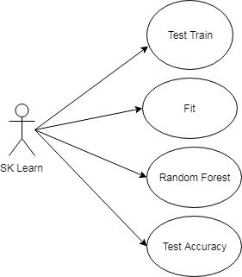
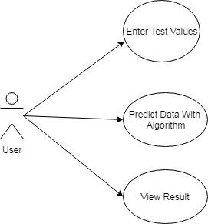
Usecase

Slide 13
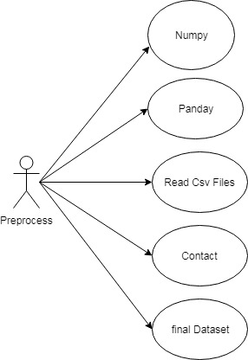

Slide 14
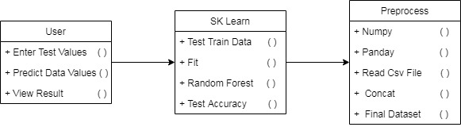
Class Diagram

Slide 15
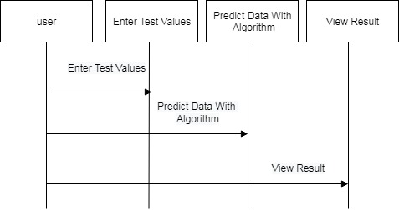
Sequence diagram

Slide 16
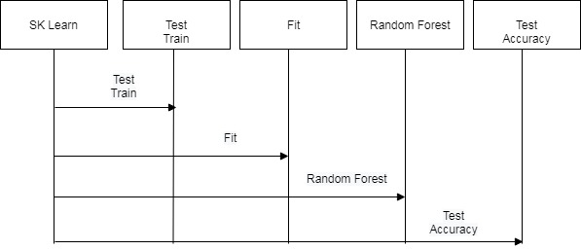

Slide 17
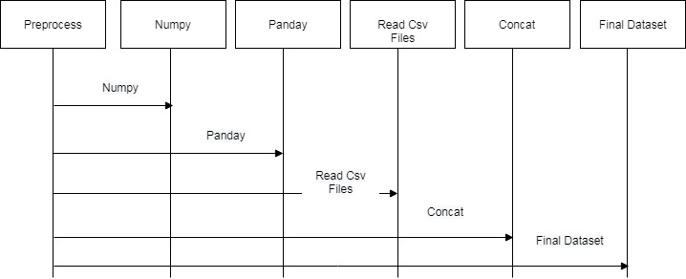

Slide 18
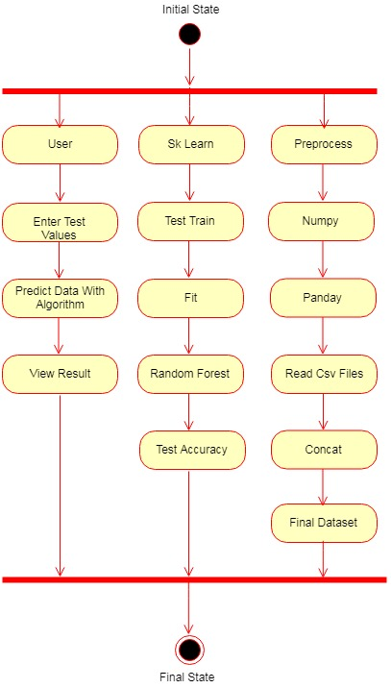
Activity Diagram

Slide 19
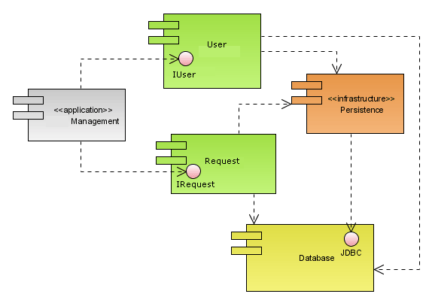
Component Diagram

Slide 20
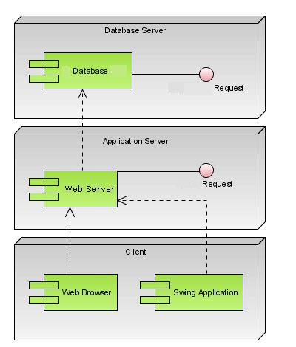
Deployment Diagram

Slide 21
References
K. Gai, M. Qiu, Z. Xiong, and M. Liu, “Privacy-preserving multi-channel communication in Edge-of-Things,” Future Generation Computer Systems, 85, 2018, pp. 190-200.
K. Gai, M. Qiu, and X. Sun, “A survey on FinTech,” Journal of Network and Computer Applications, 2017, pp. 1-12.
Abbas, K. Bilal, L. Zhang, and S. U. Khan, “A cloud based health insurance plan recommendation system: A user cen-tered approach, “Future Generation Computer Systems, vols. 43-44, pp. 99-109, 2015.
N. Khan, ML M. Kiah, S. A. Madani, M. Ali, and S. Sham-shirband, “Incremental proxy re-encryption scheme for mo-bile cloud computing environment,”The Journal of Supercom-puting,Vol. 68, No. 2, 2014, pp. 624-651.

